Slide 1
Instruction Sheet for Stress Check Test
2024/●/● ～ 2024/●/●

Slide 2
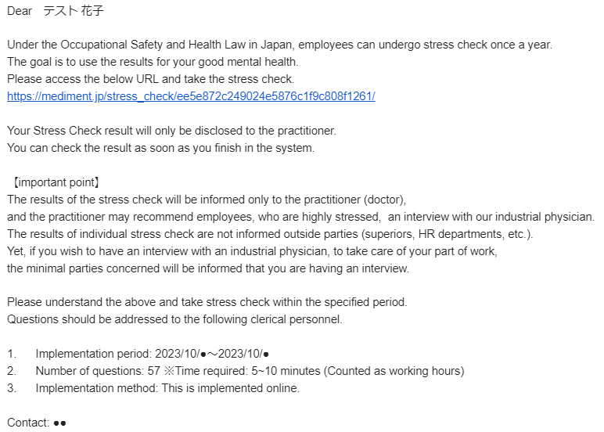
You should receive an email from mediment.
Please access the URL and take the stress check.

Slide 3
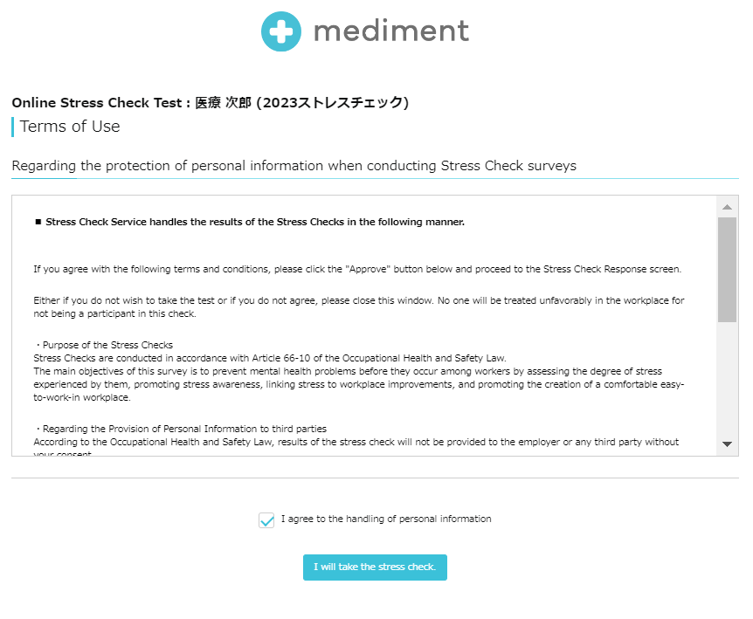
Please read the Terms of Use (Handling of Personal Information)
carefully and check the "Agree" box

Slide 4
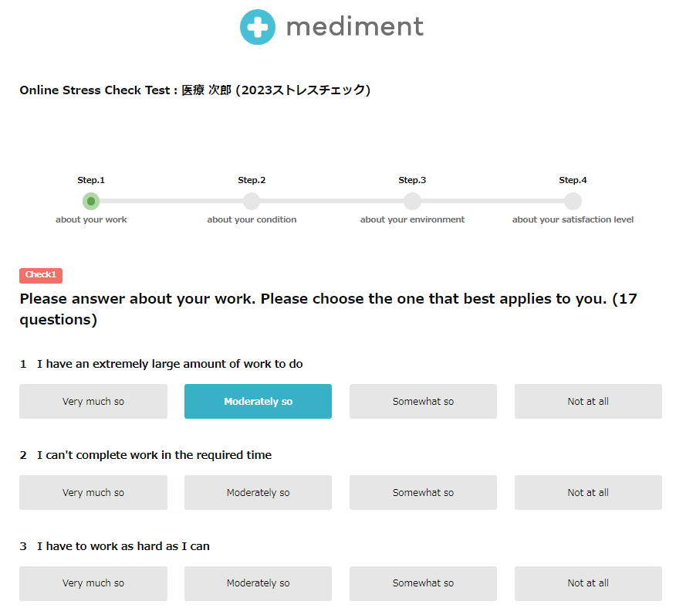
Answer the questions
(57 questions in total)

Slide 5
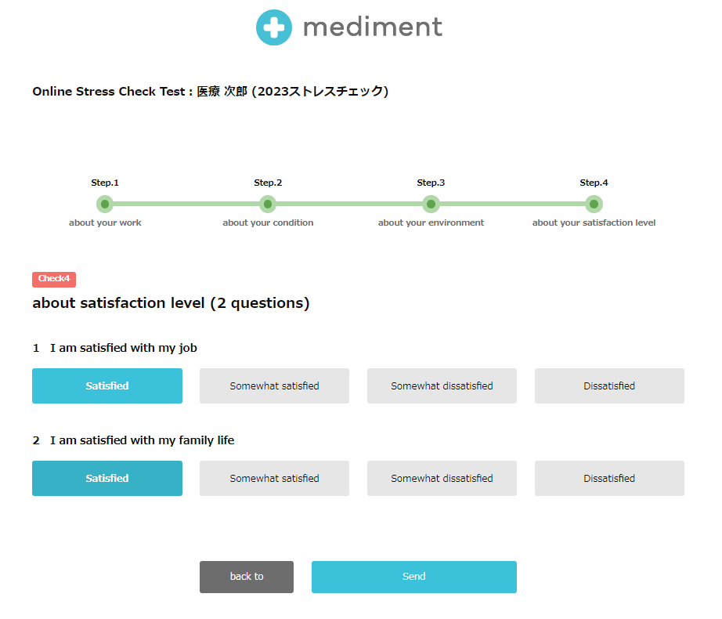
After answering all the questions,
tap the "Submit" button

Slide 6
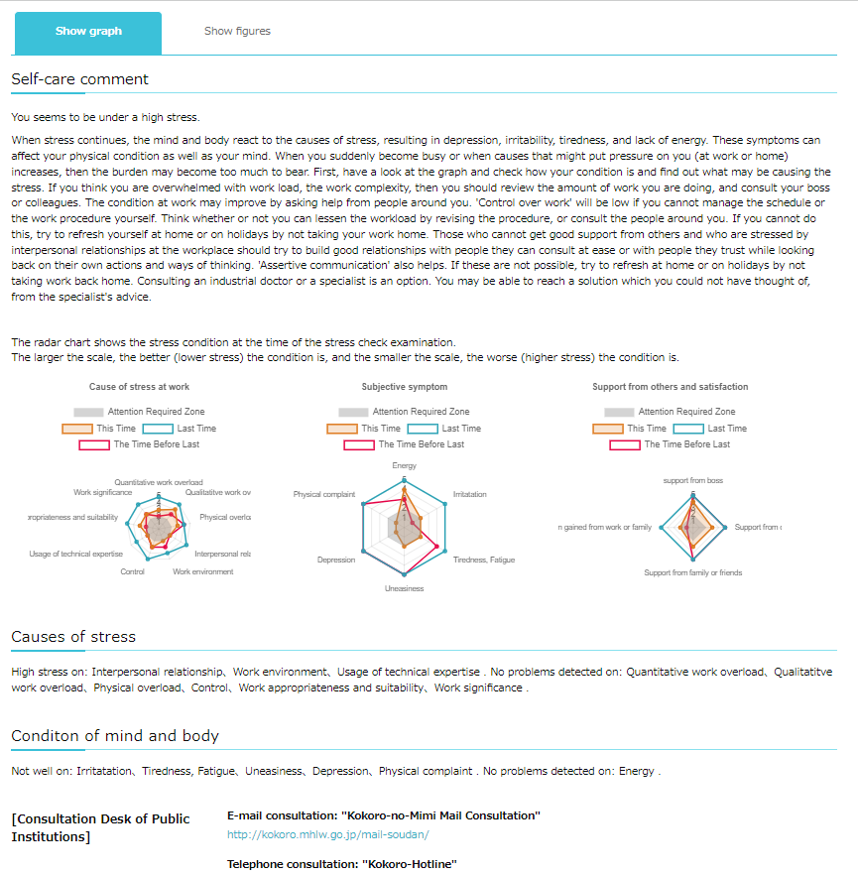
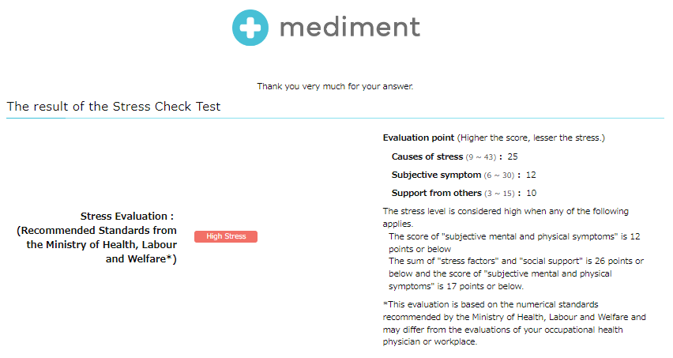
See the results
Scroll down the screen, and you will see the results.

Slide 7
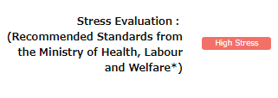
If the result is "High Stress", you will find buttons to choose whether you wish to see an occupational physician.
Select "Yes" if you wish or "No" if you do not, and tap "Submit".
(*If the result is "No Problem", the buttons will not appear.)
Result: High Stress
Result: No Problem

